Slide 1

Race Against Time
A Real-Time Challenge to Beat the TTC Bus Delay
By Group No 7

Slide 2
Introduction
Public transportation efficiency is crucial for urban mobility. Delays in transit services, such as those experienced by the Toronto Transit Commission (TTC), directly impact commuter satisfaction and overall transit reliability. In this project, we build on our Capstone Phase 1 Project’s Exploratory Data Analysis (EDA) by developing machine learning models and leveraging Azure Cloud ML services to predict delays and offer actionable insights.

Slide 3
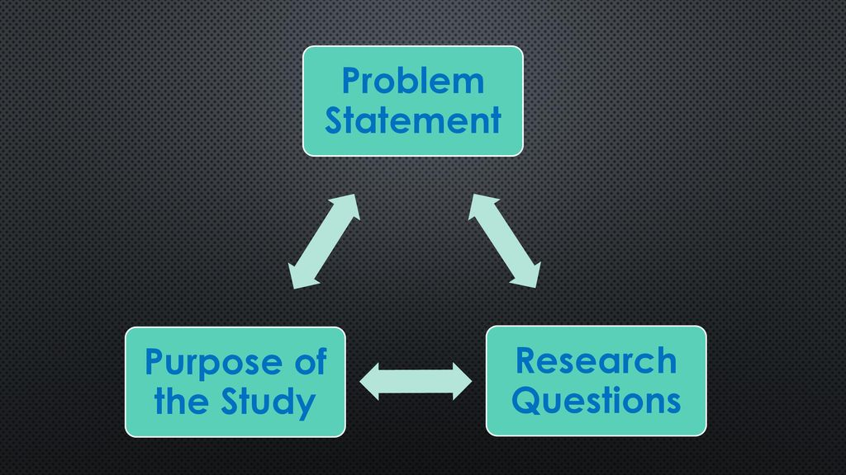
Problem Statement/Research Questions
Research Questions
Which factors (e.g., time, route, location, weather conditions) most significantly contribute to delays?
Can integrating operational data with climatic variables improve delay forecasting?
How effective are various modeling techniques (time series, machine learning, deep learning) in predicting both the occurrence and duration of delays?
Research Problem
How can detailed transit and environmental data be used to predict TTC delays accurately?

Slide 4
About Dataset
Project Name:
Race Against Time: A Real-Time Challenge to Beat the TTC Bus Delay!
Data Sources:
TTC Bus Delay Data: https://open.toronto.ca/dataset/ttc-bus-delay-data/
Weather Data : Open Data portal – City of Toronto Website
Dataset Features:
Dependent Variable: Bus delay times.
Operational variables and temporal variables : Day, route, time, incident, delay type, direction.
Weather & Climate Metrics: Climate ID, Max Temp (°C), Min Temp (°C), Mean Temp (°C), Heat Deg Days (°C), Cool Deg Days (°C)
Ethical Considerations:
Ensure data is used responsibly and transparently.
Avoid discriminatory or harmful interpretations.

Slide 5
Methodology
Project Phases:
Phase 1: Conducted EDA to explore patterns in delay records, examining correlations between operational details (e.g., route, time, incident type) and creating Tableau visualizations .
Current Phase (Part 2): To predict delay and probability using various modelling approaches. To leverage cloud services for data ingestion pipeline and deploying final model in cloud.
Data Approach: Utilize both historical delay data and weather metrics to build a comprehensive feature set for predictive modeling. Use Azure cloud for students subscription to leverage data analytics services.

Slide 6
Modelling
Proof of Concepts on forecasting techniques using time series models like ARIMA and SARIMA to capture potential temporal patterns in delays.
Machine Learning Approaches: Random Forest Regressor/Classifier and Logistic Regression to handle non-linear relationships between delay factors. XGBoost regressor for advanced gradient boosting.
Deep Learning Models: LSTM and GRU to model sequential dependencies, particularly useful with time and weather series data. Multi-Layer Perceptron (MLP) for capturing complex interactions.
Probabilistic Forecasting: Monte Carlo simulations to estimate delay probabilities and variability by integrating weather data
Feature Engineering and Hyper parameter tuning to increase model efficiency and performance.
POC on Azure ML workspace to deploy model in cloud

Slide 7
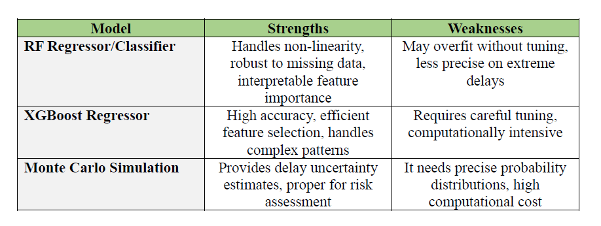
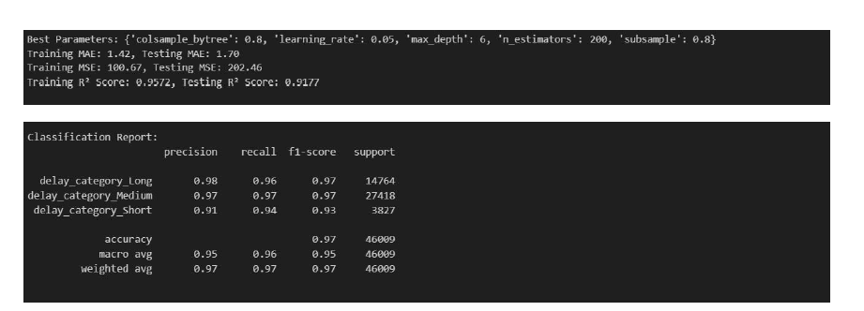
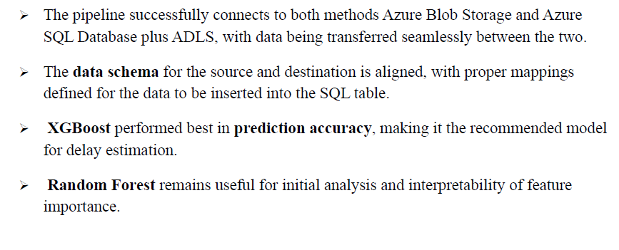
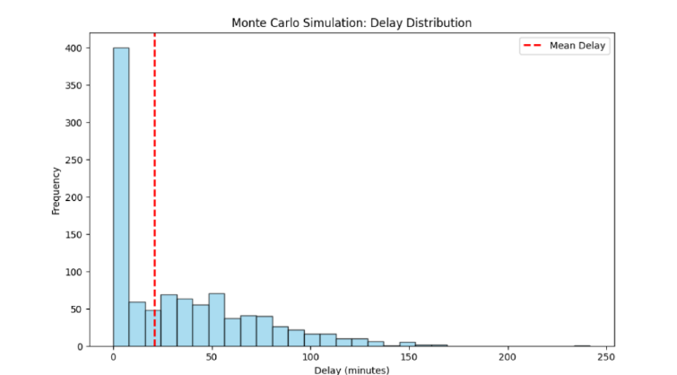
Key Insights

Slide 8

Key Challenges
XGBoost modelling requires careful tuning of hyperparameters to prevent overfitting.
Monte Carlo simulations involved careful considerations in severe weather conditions data variables like precipitation levels.
Inconsistent formats across different time-related fields and missing values in some weather metrics
Encountered connection issues to Azure SQL Database that were resolved by configuring the correct firewall rules and ensuring that the integration runtime had access.
The connection to the server was not established initially while setting up ADLS. The linked service on Azure Data Factory was fixed by adjusting the networking connection on Azure Data Studio.

Slide 9
Next Steps
Implement different model approaches executed as POC i.e., proof of concepts in VS code/Jupyter Lite on Azure ML services and validate their effectiveness
Documentation & Knowledge Sharing
SQL Database Verification: Validate that data was successfully ingested into the Azure SQL database by running SQL queries on the target table.
Deploy the best-performing model in an automated prediction pipeline.
Validate predictions against real-time bus delay data.
Test Monte Carlo simulations efficiency for the entire dataset.

Slide 10
Future Work
Model Enhancements:
Explore ensemble modeling techniques to combine strengths from multiple approaches.
Expand analysis to include additional transit modes and broader geographic regions.
Scalability & Operationalization:
Transition from research to a production-level system with continuous feedback loops.
Integrate real-time external data (e.g., social media, traffic feeds) for improved accuracy.
Long-Term Vision:
Develop a proactive transit management system that dynamically adjusts operations to minimize delays.

Slide 11
References
https://learn.microsoft.com/en-us/training/modules/intro-to-azure-data-factory/1-introduction
https://scikit-learn.org/stable/modules/ensemble.html
https://www.tensorflow.org/tutorials
https://open.toronto.ca/dataset/ttc-bus-delay-data/

Slide 12
Thank You !
Together, let's work towards smoother, faster journeys!
We appreciate you taking the time to explore the path toward a more efficient TTC.
Questions or Feedback?

